Slide 1
Splash Screen

Slide 2
Chapter Overview 2
Culture
Summary of Topics
The Basis of Culture
Language and Culture
Norms and Values
Beliefs and Material Culture
Cultural Diversity and Similarity
Click on a hyperlink to view a topic or click on the right arrow to proceed through the chapter

Slide 3
Chapter 3
The Basis of Culture
Culture defines how people in a society behave in relation to others and to physical objects.
Although most behavior among animals is instinctual, human behavior is learned.
Even reflexes and drives do not completely determine how humans will behave, because people are heavily influenced by culture.

Slide 4
Chapter 4
Culture and Society
Culture consists of the knowledge, language, values, customs, and physical objects that are passed from generation to generation among members of a group.
Culture and society are tightly interwoven. One cannot exist without the other.
A society is a group of people who live in a defined territory and participate in a common culture.
Culture is that society’s total way of life.

Slide 5
Chapter 5
Culture and Heredity
Nonhuman animals are highly dependent on instincts for survival.
Instincts are genetically inherited patterns of behavior. They are innate (unlearned).
Human infants, in contrast, cannot go very far on instincts alone.
Instincts are not enough to solve the problems that humans face.
Without controlling instincts, humans are forced to create and learn their own ways of thinking, feeling, and behaving.

Slide 6
Chapter 6
Heredity and Behavior
“Nature versus nurture” is the argument about how much of personality is a result of heredity and how much is the product of the environment.
Research with identical twins has determined that about half of your personality traits are determined by your genetic makeup and about half by environmental factors.
In addition to heredity and environment, humans also have reflexes and drives.
Culture channels the expression of these biological characteristics.

Slide 7
Chapter 7
Heredity and Behavior
reflexes: automatic reaction to physical stimulus
examples: a human baby cries when pinched; the pupils of the eyes contract in bright light
drives: impulses to reduce discomfort
examples: wanting to eat, drink, sleep, and associate with others

Slide 8
Chapter 8
Sociobiology
Sociobiology is the study of the biological basis of human behavior.
It combines Darwin’s theory of natural selection with modern genetics.
Sociobiologists assume that the behaviors that best help people are biologically based and transmitted in the genetic code.
The major criticism of sociobiology is that the importance placed on genetics could be used as a justification to label specific races as superior or inferior.

Slide 9
Chapter 9
Middle Ground
A growing body of sociologists believe that genes work with culture in a complex way to shape and limit human nature and social life.
Because of the speed of discoveries in biology, the relationships between heredity, culture, and behavior are of growing interest to sociobiologists.

Slide 10
Chapter 10
Predict which of the following are drives (D), which are reflexes (R), which are instincts (I), and which are creations of culture (C).
R
___ a. eye blinking in dust storm
___ b. need for sleep
___ c. reaction to a loud noise
___ d. socialism
___ e. reproduction
___ f. racial inequality
D
I/R
C
D
C
Click the mouse button or press the space bar to display the answers.

Slide 11
Chapter 11
Language and Culture
Humans can create and transmit culture.
The symbols of language play a role in determining people’s views of reality.
The creation and transmission of culture depend heavily on the use of symbols.
The most powerful symbols are those that make up language.

Slide 12
Chapter 12
What Are Symbols?
Symbols are things that stand for or represent something else, such as physical objects, sounds, smells, and tastes.
The meaning of a symbol is not based on physical characteristics.
example: There is nothing naturally pleasing about the sound created by hands loudly clapping together, but applause warms the hearts of entertainers, politicians, and high school athletes in the United States.

Slide 13
Chapter 13
How are Language and Culture Related?
Language frees humans from the limits of time and place.
Language allows us to read, discuss, and recombine existing ideas and technology to create culture.
Equipped with language, humans can pass their experiences, ideas, and knowledge to others.

Slide 14
Chapter 14
The Sapir-Whorf Hypothesis
Also known as the Hypothesis of Linguistic Relativity
According to Edward Sapir (1929) and Benjamin Whorf (1956), language is our guide to reality.
How we think about a thing relates to the number and complexity of words available to describe that thing.
Most people confine themselves to the language and vocabulary they learned from birth.
People can begin to view the world differently as they learn a new language or vocabulary.

Slide 15
Chapter 15
What are symbols?
Symbols are things that stand for or represent something else.
How does language affect culture?
Language affects culture in different ways. It helps define reality by restricting thought to available words. It shapes behavior in the same manner.
Click the mouse button or press the space bar to display the answer.

Slide 16
Chapter 16
Norms and Values
Two essential components of culture are norms and values.
There are several types of norms–folkways, mores, and laws.
Sanctions are used to encourage conformity to norms.
Values, the broadest cultural ideas, form the basis for norms.

Slide 17
Chapter 17
Norms: The Rules We Live By
Sociologists classify the elements of a particular way of life by defining components of a culture: its norms, its values and beliefs, and its use of material objects.
Norms are rules defining appropriate and inappropriate behavior.
Norms help to explain why people in a society or group behave similarly in similar circumstances.
Values are broad ideas about what most people in a society consider to be desirable.
Different societies or different groups within the same society can have quite different norms based on the same value.

Slide 18
Chapter 18
William Sumner
William Graham Sumner (1906) stated that anything can be considered appropriate when norms approve of it.
Once norms are learned, members of a society use them to guide their social behavior.
Norms are so ingrained they guide behavior without our awareness.
Sumner identified three basic types of norms: folkways, mores, and laws.

Slide 19
Chapter 19
Folkways, Mores, and Laws
Rules that cover customary ways of thinking, feeling, and behaving but lack moral overtones are called folkways.
The term mores (pronounced “MOR-ays”) is based on the word moral. Mores are norms of great moral significance. The most serious mores are taboos.
Laws are norms that are formally defined and enforced by officials.

Slide 20
Chapter 20
Enforcing the Rules
Sanctions are rewards and punishments used to encourage conformity to norms. (They can be positive or negative.)
Formal sanctions may be applied only by officially designated persons, such as judges and teachers.
Informal sanctions are sanctions that can be applied by most members of a group.
We sanction ourselves mentally–most of us conform to norms because we believe that the behavior expected of us is appropriate, because we wish to avoid guilt feelings, or because we fear social disapproval.

Slide 21
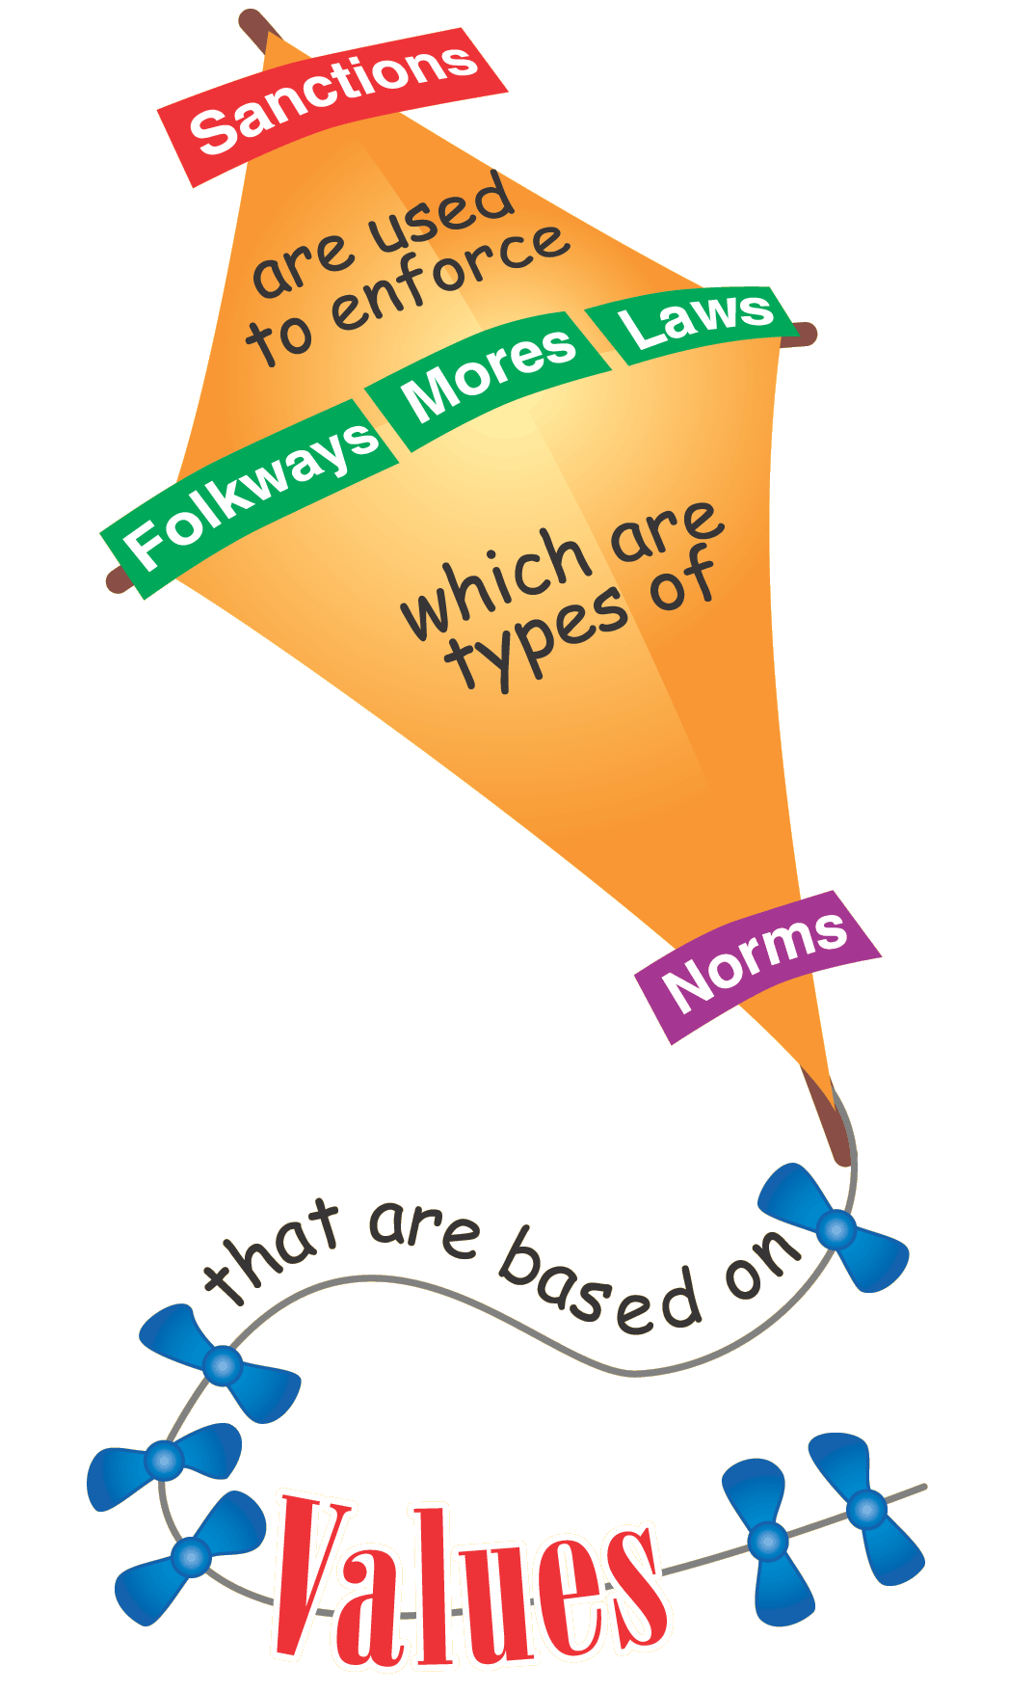
Chapter 20a
Values–The Basis of Norms
Values are broad ideas about what most people in a society consider to be desirable.
Different societies or different groups within the same society can have quite different norms based on the same value.

Slide 22
Chapter 21
Indicate whether these statements best reflect a folkway (F), a more (M), a law (L), or a value (V).
M
___ a. norm against cursing aloud in church
___ b. norm encouraging eating three meals daily
___ c. idea of progress
___ d. norm against burning a national flag
___ e. norm encouraging sleeping in a bed
___ f. norm prohibiting murder
___ g. norm against overtime parking
___ h. idea of freedom
F
V
M/L
F
L
L
V
Click the mouse button or press the space bar to display the answers.

Slide 23
Chapter 22
Beliefs and Material Culture
Besides norms and values, beliefs and physical objects make up culture.
Ideal culture includes the guidelines we claim to accept, while real culture describes how we actually behave.

Slide 24
Chapter 23
Nonmaterial Culture
The nonmaterial culture involves beliefs, ideas, and knowledge that influence people’s behavior.
Beliefs are ideas about the nature of reality.
Beliefs can be true or false.
Beliefs are important because people base their behavior on what they believe, regardless of how true or false the beliefs are.

Slide 25
Chapter 24
Material Culture
Material culture consists of the concretely tangible objects within a culture.
These physical objects have no meaning or use apart from the meanings people give them.
The uses and meanings of physical objects can vary among societies.
The cultural meanings of physical objects are based on the beliefs, norms, and values people hold with regard to them.

Slide 26
Chapter 25
Ideal and Real Culture
A gap sometimes exists between cultural guidelines publicly embraced by members of a society (ideal culture) and actual behavior patterns, which often conflict with these guidelines (real culture).
In an imperfect world, ideal culture provides high standards and permits the detection of deviant behavior.

Slide 27
Chapter 25a
How is the material culture influenced by the nonmaterial culture?
How objects are used is a function of ideas about the objects and the values and needs of the society.

Slide 28
Chapter 26
Cultural Diversity and Similarity
Cultures change according to three major processes: discovery, invention, and diffusion.
While apparently very different on the surface, all cultures have common traits or elements that sociologists call cultural universals.
Discovery is the process of finding something that already exists.
Invention is the creation of something new.
Diffusion is the borrowing of aspects of culture from other cultures.

Slide 29
Chapter 27
Cultural diversity exists in all societies.
Social categories are groupings of persons who share a social characteristic.
Subcultures are groups that are part of the dominant culture but that differ from it in some important respects.
Countercultures are subcultures that are deliberately and consciously opposed to certain central beliefs or attitudes of the dominant culture.
Ethnocentrism occurs when people judge others in terms of their own cultural standards.

Slide 30
Chapter 28
Cultural Universals
Cultural universals are general cultural traits that exist in all cultures.
Cultural particulars are the ways in which a culture expresses universal traits.
Why do cultural universals exist?
The biological similarity shared by all human beings helps to account for many cultural universals.
The physical environment provides another reason.
Societies face many of the same social problems.

Slide 31
Chapter 29
Identify each of the following as a social category (SC), subculture (S), or counterculture (C).
S
_____ a. Chinatown in New York City
_____ b. motorcycle gang
_____ c. Catholics
_____ d. females
_____ e. revolutionary political group
_____ f. the super rich
C
SC
SC
C
S/SC
Click the mouse button or press the space bar to display the answers.

Slide 32
Summary
Chapter Summary
Culture defines how people in a society behave in relation to others and to physical objects.
Instincts, reflexes, and drives do not completely determine how humans behave because human behavior is learned, and is heavily influenced by culture.
The symbols of language play a role in the creation and transmission of culture, and in the way people view reality.
The essential components of culture are norms, values, beliefs, and material objects.
Continued on next slide.

Slide 33
Summary2
Chapter Summary (cont.)
Ideal culture includes the guidelines we claim to accept, while real culture describes how we actually behave. Culture changes according to three major processes.
While apparently very different, all cultures have common traits or elements that sociologists call cultural universals.

